Slide 1
1:1 TECHNOLOGY
One Student : One Laptop

Slide 2
What are the benefits?
School Work/Homework
Research
Creation
Communication
Collaboration
Problem-Solving
Data Analysis
Other Learning Activities

Slide 3
What are some concerns?
Digital Citizenship
Responsibility
Care and Safety of the Netbook
Internet Accessibility
Cyber-Bullying
Online Safety

Slide 4
A Whole New World
Computer Skills
Communication Skills
Collaboration Skills
Creativity Skills

Slide 5
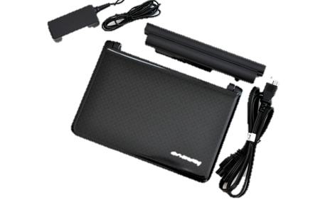
1:1 Computers
When do students get their computers?
1st Block
6th Grade: 8/23
7th Grade: 8/22
8th Grade: 8/22

Slide 6
Taking Laptops Home
One form due before you can take your computer home: The Laptop Agreement
A student cannot take his/her laptop home without first turning in the Laptop Agreement Form (return to & leave laptops in Block 1 until the next day)
Students cannot use their laptops on bus rides home. Keep them safe in backpacks or computer bags.

Slide 7
Homeroom Lessons in the coming days
Care & Safety
Procedures & Troubleshooting
Cyber-Bullying
Digital Citizenship
Digital Responsibility/Safety

