Slide 1
Handle With Care
How To Treat Your Laptop

Slide 2
Who is responsible?
You are responsible for the care and safety of your laptop.

Slide 3
Carrying Your Laptop
Class to class: Use your backpack or computer bag – zipped shut!
Don’t swing the bag.
Don’t throw the bag down – on a desk, on the floor, etc.
In a class: Carry with two hands.
Do not carry your laptop by the screen or by a corner of the laptop!!

Slide 4
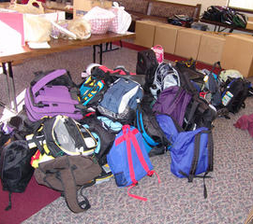
Be Careful…
Ask your PE teacher where to place backpacks during PE so that they are out of the way.
When outside for Friday BLAST, don’t throw your back pack down with your computer in it; don’t pile up backpacks.
If storing backpacks in an area in a classroom, do so carefully.

Slide 5
Placement of Your Laptop
When possible, use a flat desktop or table.
Don’t place open drinks or food near your laptop.

Slide 6
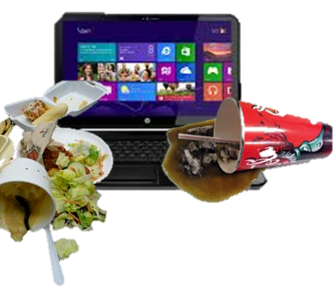
Lunch & Bus
Don’t use your laptop in the cafeteria.
Don’t use your laptop on the bus ride home.
During lunch & during your bus ride, you laptop should be in your backpack.

Slide 7
Double Check
If you lose or damage your charger, the cost is approximately $28.00 for the replacement.
Before leaving a class make sure you have YOUR computer and YOUR charger.
Once again:
Before leaving a class make sure you have YOUR computer and YOUR charger.

Slide 8
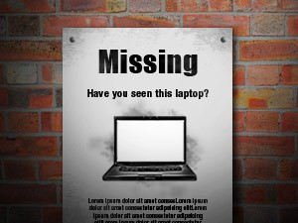
If you lose your laptop
If you lose or can’t find your laptop, tell your teacher IMMEDIATELY.
The sooner we know, the better chance we have of finding it.
Do NOT wait. Tell a teacher right away.

Slide 9
Mind your charging cord!
Charge your computer at home every night so that you won’t run out of juice!
Be careful at home and at school so that you and/or others don’t trip over your computer cord.

Slide 10
Computer/Charger Labels
Do NOT peel off or damage your computer label and/or the label on your charger.
Once again:
Do NOT peel off or damage your computer label and/or the label on your charger.

Slide 11
Handle With Care
Don’t pound on your keyboard.
Don’t shake your laptop.
Don’t stack or put heavy things on top of it.
Don’t close the lid when something is on the keyboard (like a pencil, etc.)

Slide 12
...you are responsible.
If your computer is damaged...
I
$600
$600

Slide 13
It is YOUR Laptop to Use
Do NOT loan your laptop or power cord to other students.
If you loan your charger & someone loses it, you are still responsible for the replacement.

Slide 14
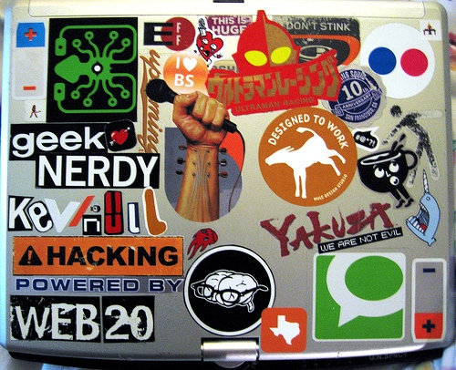
Case, Screen, & Keyboard
If you decorate, please use removable decals instead of permanent stickers.
DO NOT cover the name tag.
DO NOT remove or damage the name tag on laptop or the charger.
DO NOT decorate the bottom of the laptop and/or cover vents.

Slide 15
Downloads
Do not download anything (programs, fonts, screensavers, etc.) without checking first with a teacher or your parent.
If your laptop gets a virus, it will be re-imaged – and you will lose your work and what you have downloaded.

Slide 16
Back up your work!
Save all your work to your H drive and/or to Google drive.

Slide 17
Something Wrong?
If you notice that something is wrong, tell your teacher as soon as you realize it.

