Slide 1
Troubleshooting
Steps You Can Take

Slide 2
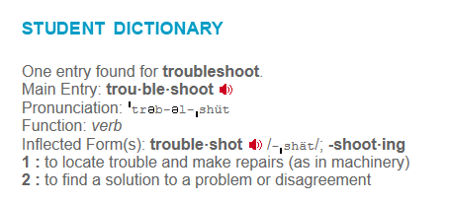
Troubleshooting
What does “troubleshoot” mean?

Slide 3
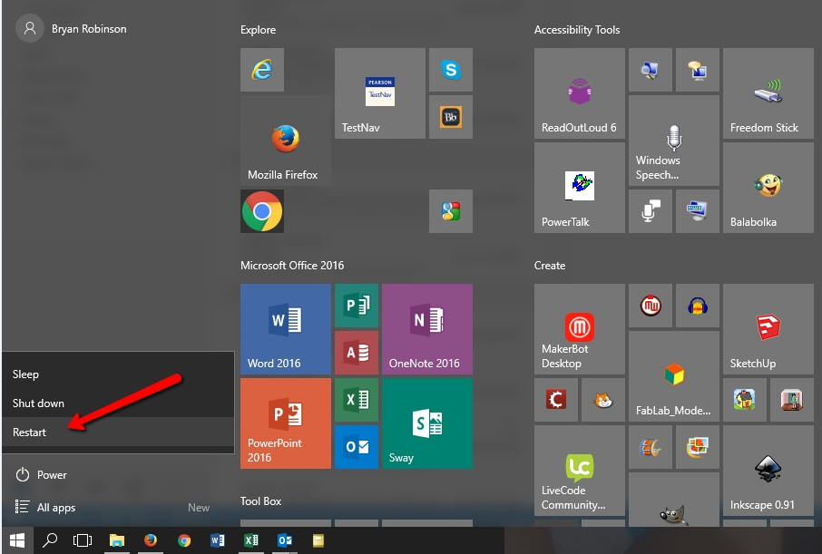
Restart the Laptop
When your laptop is not working correctly, your first step should be to restart it by clicking on the power icon and then selecting Restart.

Slide 4
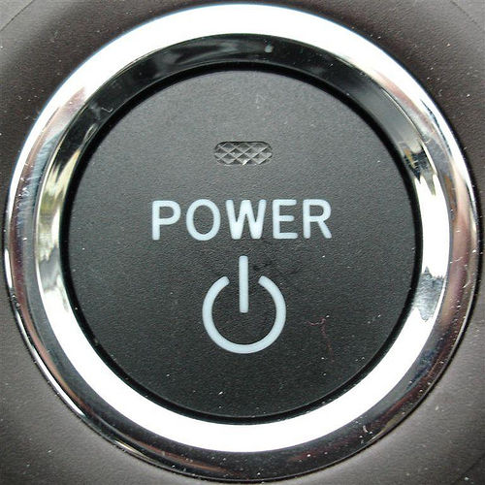
Restart Regularly!
Regularly restart your laptop during Morning Announcements.
Restarting allows updates to be installed and clears out the memory…speeding up your computer!

Slide 5
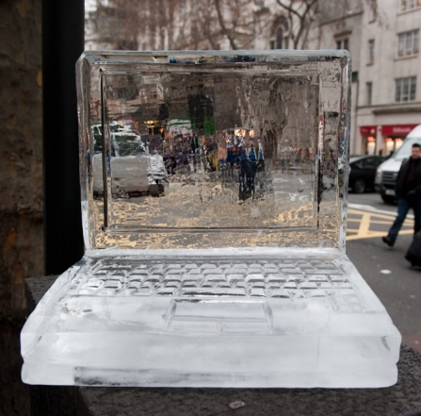
A “Frozen” Laptop
What should I do if my laptop is frozen and I can’t restart it using the power icon on the desktop?

Slide 6
“Frozen”
IF THE COMPUTER IS FROZEN & WON’T LET YOU RESTART: Complete a “HARD” shut down:
Hold down the power button until the machine cuts off. After 30 seconds, turn your laptop back on.

Slide 7
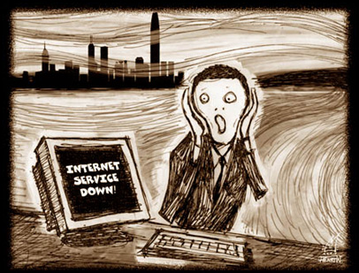
No Internet Connection
What should I do if I cannot connect to the network or browse the Internet?

Slide 8
Connect to ACPS
Click on the wi-fi icon.
Click on ACPS to connect to the network (not ACPS-Public)

Slide 9
No Power? No Charge?
What if my laptop won’t turn on?

Slide 10
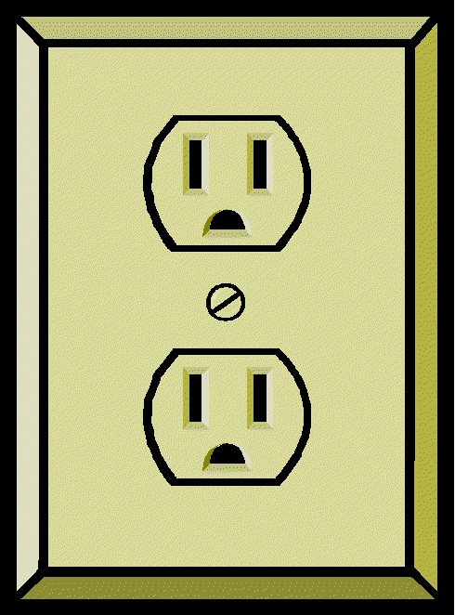
No Power? No Charge?
Try plugging your AC adapter into the wall because your battery may be dead or unable to hold a charge.
Make sure your computer is plugged in correctly. Are the two pieces of your charger connected correctly? Is the charger plugged into the laptop?
If this doesn’t work, try another receptacle (to make sure there isn’t a faulty receptacle).

Slide 11
What if my laptop still won’t work?
Loaners are available in the morning: bring your laptop to the Library when the 8:55 bell rings.
You may also bring your laptop in for repairs during Homeroom. Our Student Help Desk will be open in the Library.
If your laptop is turned in for repair, you can take a “loaner” home.
If you forgot your laptop at home, you will not be able to get a loaner for the school day!

Slide 12
How do I turn my computer in for repairs?
Here’s What to Do:
Find the loaner cart in the library.
Fill out the form on top of the cart COMPLETELY!
Place the form inside your laptop.
Check out a loaner.
Notes:
Teachers: Please touch on these points.
Be specific in describing what is wrong with you laptop!
Write your full, official name.
Fill out every blank on the form.
If you are turning in your charger, tape the form to the charger.
Place the laptop in the “Fix Me” crate.
Check out the loaner the same way you would check out a book from the library.

Slide 13
