Slide 1
Haters and Trolls and Bears, Oh My!
Social Media: Being Responsible Online

Slide 2
QUICK POLL: YES OR NO?
Has anyone ever been mean or hurtful to you online?
Have you been mean or hurtful to another person online? (even if not intentional …and you realized it later).

Slide 3
Click here to see more stats from TeenSafe.

Slide 4
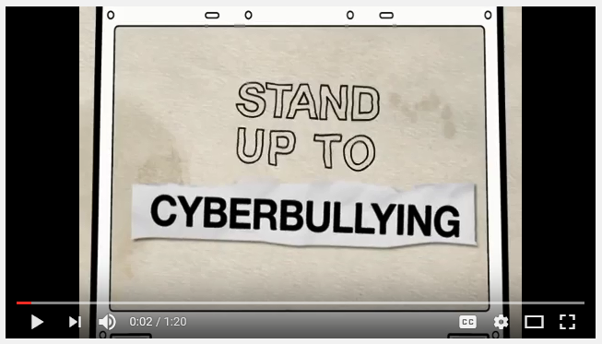

Slide 6
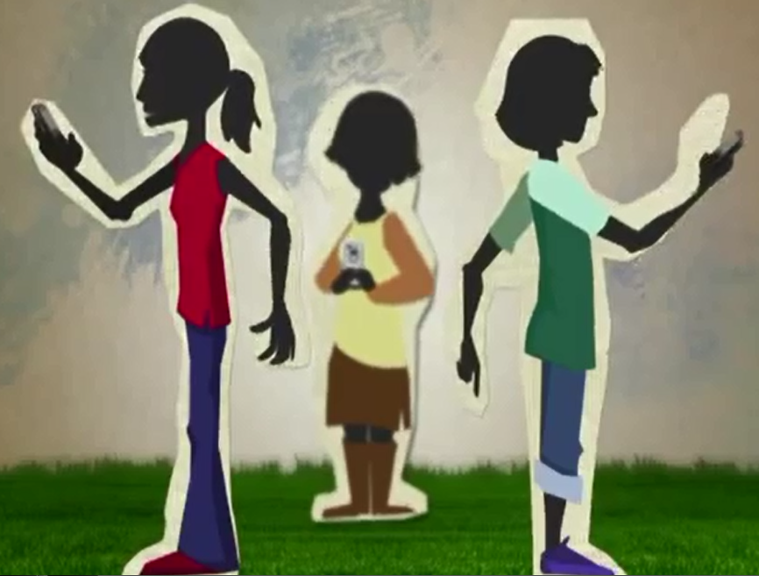
3 CASE STUDIES

Slide 7
How to address cyber-bullying?
Brainstorm a list of ways to address cyber-bullying.
Notes:
Have this discussion after you finish Case Study 3

Slide 8
Don't pass along cyberbullying messages.
Don’t respond to any cyberbullying messages.
Block all communication with cyberbullies.
Set an example and discourage your friends from bullying others.
Set an example and post nice things to and about other people.
Report cyberbullying to a trusted adult as soon as you aware of a bad situation.
If you are in school, speak with other teachers, counselors and/or school administrators if you are aware of cyberbullying.
How to address haters and trolls?

