Slide 1
ONLINE SAFETY
What Should You Do?
What Should You NOT Do?

Slide 2
PRIVATE VS. PUBLIC INFO
Do NOT give out personal information.
Use privacy settings if/when applicable
(for ex: keeping an
Instagram account
“private”)

Slide 3
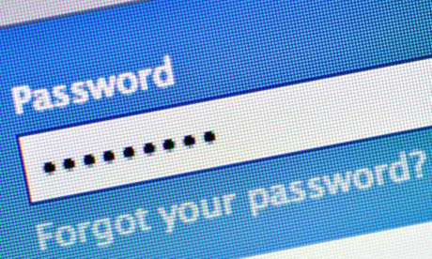
PASSWORDS
Do NOT share your passwords.
Be sure to
LOG OFF if
you leave your
computer.

Slide 4
NO DOWNLOADS
Do NOT download or install anything (including apps) on your computer unless you ask a teacher or parent first to confirm that it is okay.

Slide 5
AVOID COMPUTER VIRUSES
Do NOT click on links and/or attachments from suspicious emails (whether from strangers, companies, or even friends).

Slide 6
CIVILITY
Do NOT send or respond to mean messages.
If you are aware of cyber-bullying tell your parent and a teacher or your counselor as soon as possible.

Slide 7
CIVILITY
If you become aware of cyber-bullying:
Do NOT respond
Tell an adult immediately.
Take a screen shot (and/or do not delete the proof).

Slide 8
Watch the Video
The link to the video is HERE.

Slide 9
Before You Post:

Slide 10
Review the Checklist!

