Slide 1
A pocket guide to exponents
When in doubt, write it out!
By Christine
It’s just repeated multiplication!

Slide 2
contents
CLOSE GUIDE
What’s a power?........................................................................................................... Page 3
Adding and subtracting exponents………………………………………………………. Page 4
Multiplying exponents……………………………………………………………………….. Page 5
Dividing exponents…………………………………………………………………………... Page 6
Raising exponents to a power……………………………………………………………... Page 8
___to the 1st power…………………………………………………………………………… Page 9
___to the 0th power…………………………………………………………………………... Page 10
Negative Powers……………………………………………………………………………… Page 11
List of Rules……………………………………………………………………………………... Page 12

Slide 3

What is a power?
$$x^{y}$$
exponent
In this diagram, the x is the base, the y is the exponent, and the whole thing is called a power.
base
power
BACK TO CONTENTS

Slide 4

adding and subtracting with exponents
$$x^{3}±x^{2}=\left(x×x×x\right)±(x×x)$$
You can’t add and subtract like-base powers—they’re already simplified.
How would you even do that?
BACK TO CONTENTS

Slide 5




Multiplying with exponents
1
2
3
4
5
6
$$x^{2}×x^{4}=x×x×x×x×x×x=x^{6}$$
$x^{2}$
$×$
$x^{4}$
To multiply powers with the same base, just leave the base alone and add the exponents.
BACK TO CONTENTS

Slide 6


dividing with exponents
BACK TO CONTENTS
The rule for dividing with exponents is to subtract the bottom from the top. More here.
$$\frac{x^{6}}{x^{4}}=\frac{x×x×x×x×x×x}{x×x×x×x}=x^{2}$$
When you have the same thing on the top and bottom of a division bar, they cancel out. (pink circles)
Simplify $x×x$, and, Viola! You’ve got $x^{2}$! (red circle)
Now, there are only 2 ‘x’s left on top. (orange circles)When there is nothing on the bottom, then you put a 1 there. The 1 means you just have wholes on top, so you could eliminate the fraction bar altogether.

Slide 7

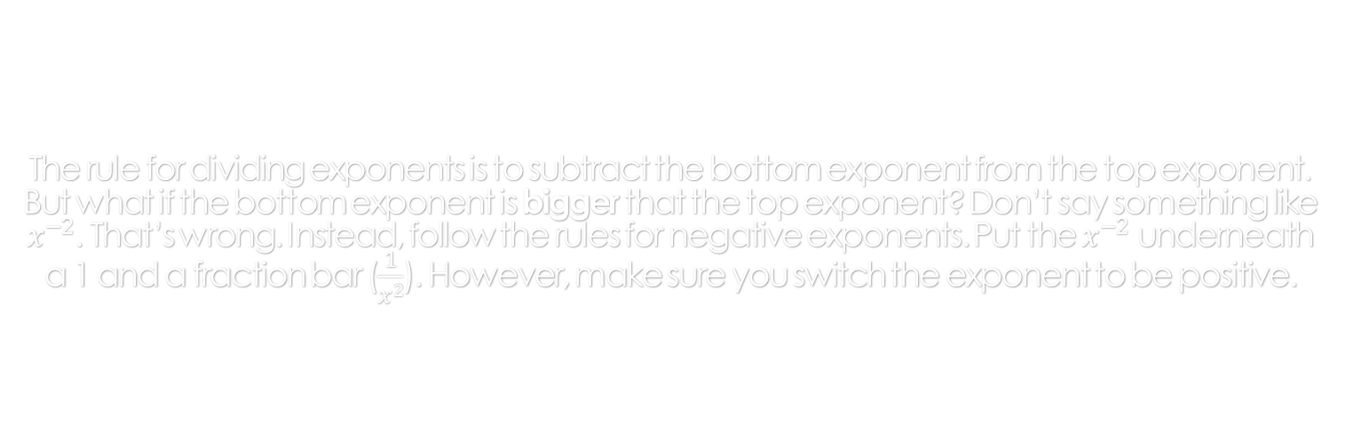
The rule for dividing exponents is to subtract the bottom exponent from the top exponent. But what if the bottom exponent is bigger that the top exponent? Don’t say something like $x^{−2}$. That’s wrong. Instead, follow the rules for negative exponents. Put the $x^{−2}$ underneath a 1 and a fraction bar ($\frac{1}{x^{2}}$). However, make sure you switch the exponent to be positive.
$$\frac{x^{4}}{x^{6}}$$
Negative exponent help here.
BACK TO CONTENTS

Slide 8





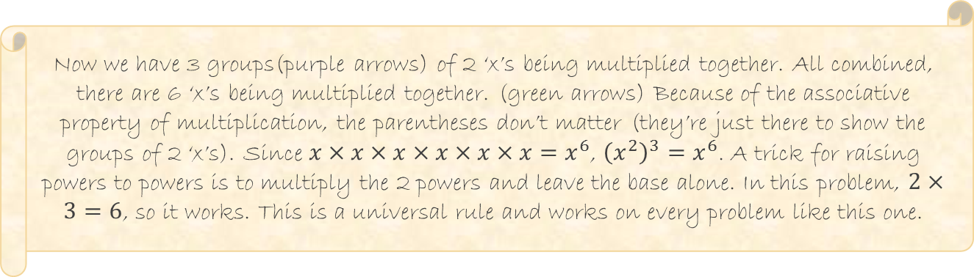

Raising powers to a power
As we know, exponents are repeated multiplication. ($x^{2}=x×x$) So this problem is just a more complicated form of that.
1
2
3
4
5
6
$${\left(x^{2}\right)}^{3}=(x×x)×(x×x)×(x×x)=x^{6}$$
$$x^{2}$$
$$x^{2}$$
$$x^{2}$$
1
2
3
Now we have 3 groups(purple arrows) of 2 ‘x’s being multiplied together. All combined, there are 6 ‘x’s being multiplied together. (green arrows) Because of the associative property of multiplication, the parentheses don’t matter (they’re just there to show the groups of 2 ‘x’s). Since $x×x×x×x×x×x=x^{6}$, ${\left(x^{2}\right)}^{3}=x^{6}$. A trick for raising powers to powers is to multiply the 2 powers and leave the base alone. In this problem, $2×3=6$, so it works. This is a universal rule and works on every problem like this one.
BACK TO CONTENTS

Slide 9

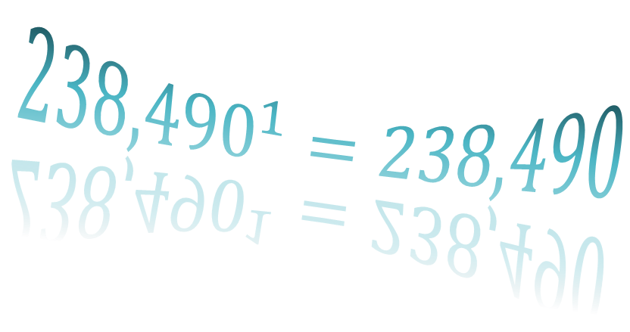
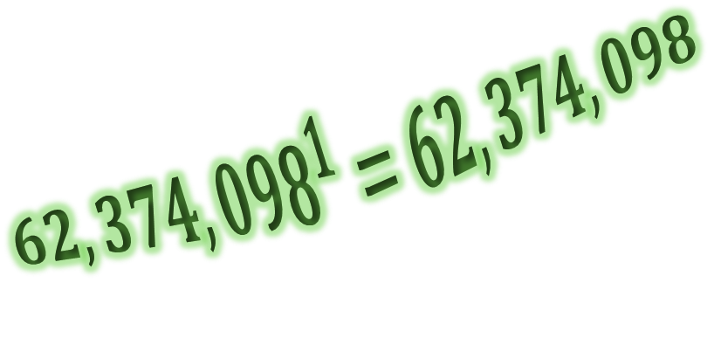
Anything to the first power
BACK TO CONTENTS
$$x^{1}=x$$
IS ITSELF
$${62,374,098}^{1}=62,374,098$$
$${238,490}^{1}=238,490$$

Slide 10

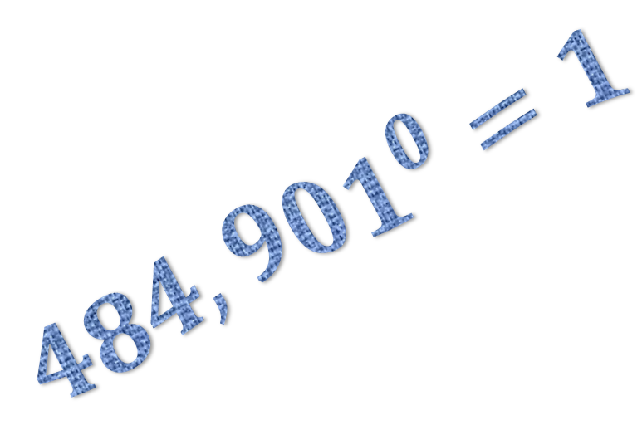
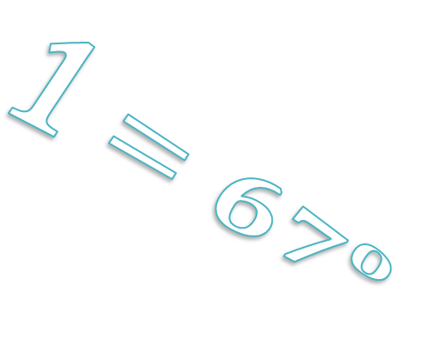

Anything to the 0th power
BACK TO CONTENTS
$$x^{0}=1$$
IS ONE
$$1={67}^{0}$$
$${484,901}^{0}=1$$

Slide 11


Negative Exponents
It’s really easy. Also, if you have a problem like this: $\frac{x^{−n}}{y^{−s}}$, simply switch which side the powers are on and make them positive, like this: $\frac{y^{s}}{x^{n}}$
When you have a negative exponent in an answer, you must change it to a fraction. Negative exponents are unacceptable as answers on a test or worksheet. They aren’t fully simplified!
$$x^{−y}=\frac{1}{x^{y}}$$
To change a negative exponent to a fraction, simple make the exponent positive, (blue circle) put it under a fraction bar(red circle) and put a 1 on top (yellow circle)
CLOSE GUIDE
BACK TO CONTENTS

Slide 12

All the Rules
BACK TO CONTENTS
To multiply powers: Add the exponents
To divide powers: Subtract the exponents
To add/subtract powers: You can’t
Anything to the 1st power is itself
Anything to the 0th power is 1
Negative exponents: Switch sides of fraction bar and make exponent positive
CLOSE GUIDE

Slide 13
A comprehensive guide to exponents that features every exponent rule in Virginia standards Algebra 1. Examples and tricks are featured for most operations. Use for review, studying, homework, anything but tests!
Published by the creators of Peachy Smiles Inc. greeting cards

Slide 14
A pocket guide to exponents
When in doubt, write it out!
Open Guide
By Christine Fernandez
It’s just repeated multiplication!

